Slide 1
GKVGT
GKV GLOBAL
TECHNOLOGY

Slide 2

Agenda
Overview of GKV Global Technology
Vision and Mission
Organization Structure
Product and Market Performance
AI/ML Products Overview
Roles and Responsibilities
Conclusion

Slide 3

About Our Company
IT Solutions, Staffing, Product Development, Software Development, Consultancy.
Founded in 2024.
Clients: QUESS, Tech Mahindra, Tata Electronics, Foxconn, etc.
Placed 600+ diploma candidates during internships.

Slide 4

GKV GLOBAL TECHNOLOGY
We are working on latest technologies and real time products developments.
It is a leading provider of comprehensive technology solution and service.
Empowering business to thrive in a rapidly evolving digital landscape.

Slide 5

About Our Vision
We are dedicated to delivering innovative solutions globally, while fostering integrity, excellence, and responsible growth.
01

Slide 6

Our Mission
Innovate through teamwork and diversity.
Achieve more together through inclusion.
Unite talents to innovate and succeed.

Slide 7

Mission
Commit to building better communities through impactful and responsible social initiatives.
01
Deliver agile, innovative IT solutions tailored to diverse industry needs.
02

Slide 8
Ensure all stakeholders benefit through responsible operations and impactful innovations.
03
Create a global learning environment that drives employee growth and excellence.
04

Slide 9
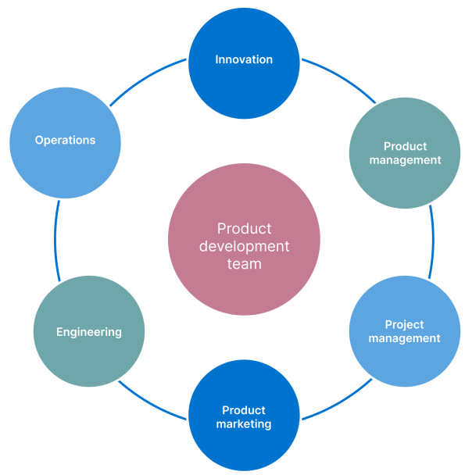
Organization Structure
Includes roles like Innovation, Product Management, Engineering, and Operations.
Teams collaborate to deliver a Complete Product Experience (CPE).

Slide 10
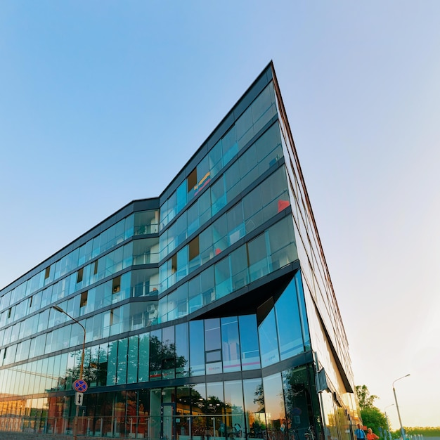
Consulting Hierarchy:
Structured as Consultant → Senior Consultant → Manager → Director → Partner.
Each role has specific responsibilities to ensure project success.

Slide 11
Cross-Functional Collaboration:
Teams work together across functions to align goals and meet customer needs.
Ensures efficient communication and avoids working in divisions.

Slide 12

Products And Market Performance
Real-Time Unknown Entry Detection
01
Wild Animal Detection for Agriculture
02
Multiple Face Recognition for Attendance
03

Slide 13

High market relevance with solutions for security, automation, and healthcare.
01
Commitment to innovation, quality, and customer satisfaction.
02
Future roadmap focuses on expanding AI/ML, partnerships, and training programs.
03

Slide 14

Roles & Responsibilities
The head of production
The head of Quality assurance
The head of Quality control

Slide 15

What We Do
Clients: Provide smart and flexible IT solutions for different industries.
Partners: Build strong partnerships that create value with technology.
Employees: Offer a supportive environment where employees can grow and excel.

Slide 16


Conclusion
GKV Global Technology is a company that started in 2024.
It helps businesses with technology solutions and services.
Be the best partner with innovative and valuable solutions.
Exclusive And
Limited

Slide 17

The company aims to be a good corporate citizen and help society.
It focuses on giving clients great value and making sure everyone benefits.
The consulting roles are clearly defined to ensure project success.

Slide 18

ANY QUETIONS...?
If you have any doubts...!, keep it yourself. Because we are not intelligent compare to you all...

Slide 19
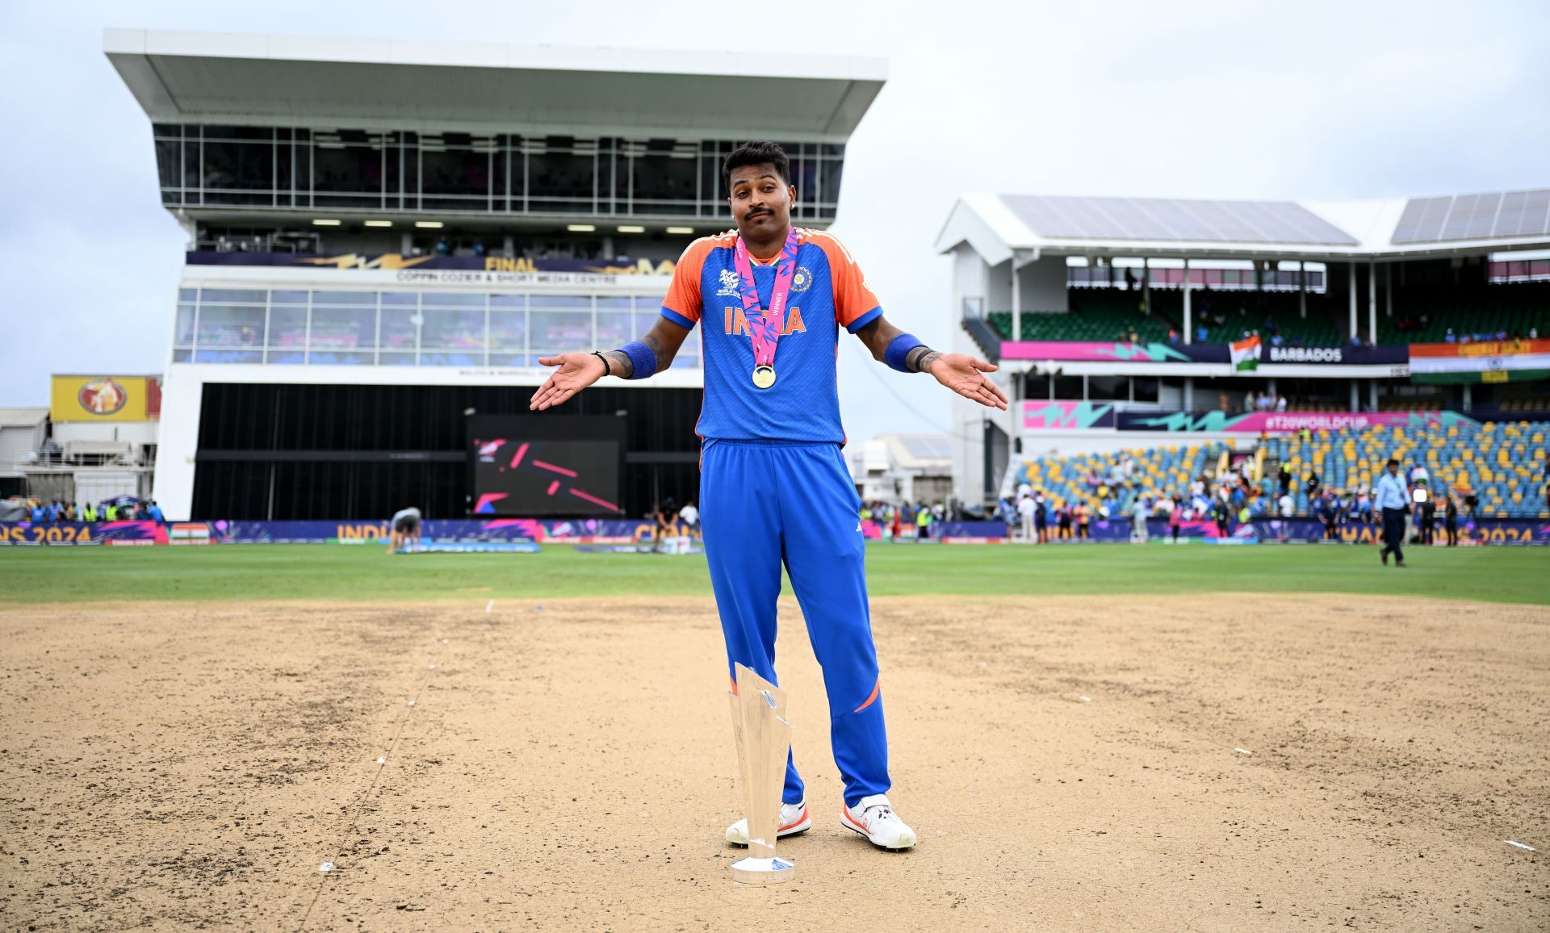



Thank You....!
Address
Mandya, shubash nagar
Email Address
gkvglobaltechnology@gmail.com
Contact Number
8892886665

